Slide 1
Bayesian Modeling: Climate Change
Chaitali Harge & Elisabeth Waldron

Slide 2
Problem Description
- Goal -
Utilize Bayesian analysis to understand and model climate change patterns
Climate change is a critical global issue with far-reaching consequences
Assess the impact of historical changes in measurement methods
Explore uncertainties associated with temperature data
Accurate temperature modeling is essential for informed decision-making and policy formulation
To evaluate whether the Industrial Revolution has accelerated climate change
Notes:
Introduction to the project's motivation: Understanding uncertainties in climate change predictions for informed decision-making.
Goals of the project: Quantifying uncertainties in climate change projections (temperature and precipitation changes), evaluating posterior probability distributions, and assessing prediction reliability.

Slide 3
Data - Description
Original Data Variables:
Around 550000 observations
Date (from year 1750 to 2013)
AverageTemperature (ranging from -37.65°C to 38.84°C)
AverageTemperatureUncertainty (95% confidence interval around the average)
Country

Slide 4
Data - Preprocessing
Missing data:
AverageTemperature: Linear Interpolation - look at the past and the future data from the missing value and ensure it can only be between two finite numbers
AverageTemperatureUncertainty: imputing using the mean (0-1)
Variable transformations:
Date: became an index
Country: United States
AverageTemperatureUncertainty: set a scaling constraint 0 to 1
Line: added variable to trace row number
Pre: Boolean value that indicates if it is prior to 1840 or post 1840

Slide 5
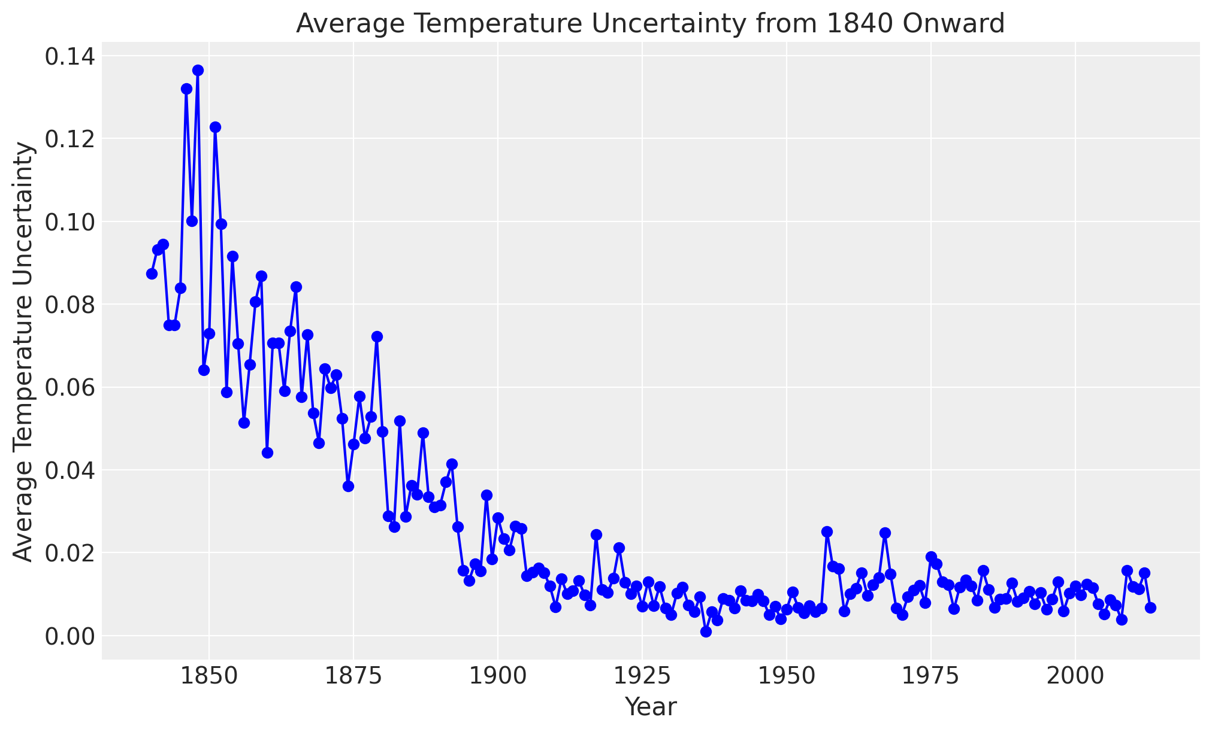
Uncertainty
Due to lack of all the information about data, and randomness
High uncertainty till year 1900
For recent years, uncertainty in the data has stabilised
Uncertainty can not be ignored —
Affecting posterior predictions
Notes:
Uncertainty in predictive data is like when we're not totally sure about the predictions we make—maybe because we don't have all the information or things are just naturally a bit random. Ignoring this uncertainty can mess with our predictions, making them not quite right. It's like assuming everything is certain when it's not, leading to predictions that might be off. So, it's important to consider this uncertainty to avoid messing up our predictions and making them more accurate.

Slide 6
Model
Approach: Split data into pre-1840 (training) and post-1840 (prediction) subsets
Priors: utilize pre-1840 temperature data, initializing the model with historical patterns.
Posteriors: represent updated beliefs about parameters after considering observed pre-1840 data.
Distributions:
Intercept, Slope - Gaussian Distribution to consider wide range of temperature fluctuations
Standard Deviation - HalfNormal to enforce positivity, and unexplained uncertainties are non-negative and continuous
Notes:
These priors guide the model's learning process, allowing it to incorporate prior information while updating beliefs based on observed data.

Slide 7
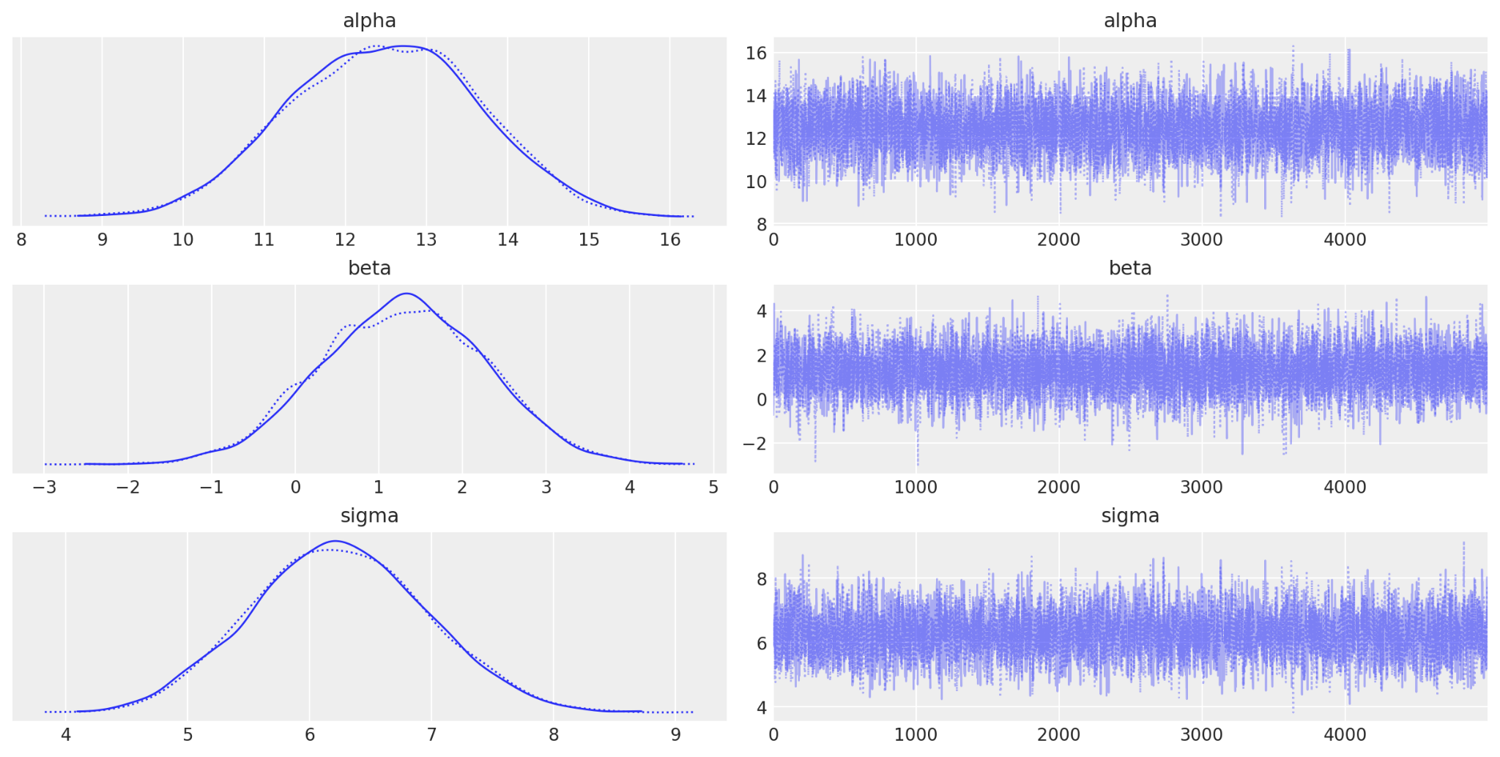
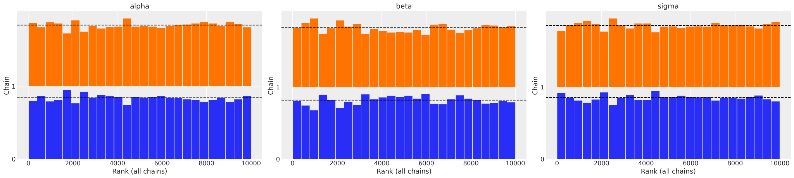
Model Plots - Trace & Rank
R-hat = 1.0
ESS > 400
The rank plots do not overlap over one another and are mostly uniform
The chains are overlapping and resemble a “hair-caterpillar”

Slide 8
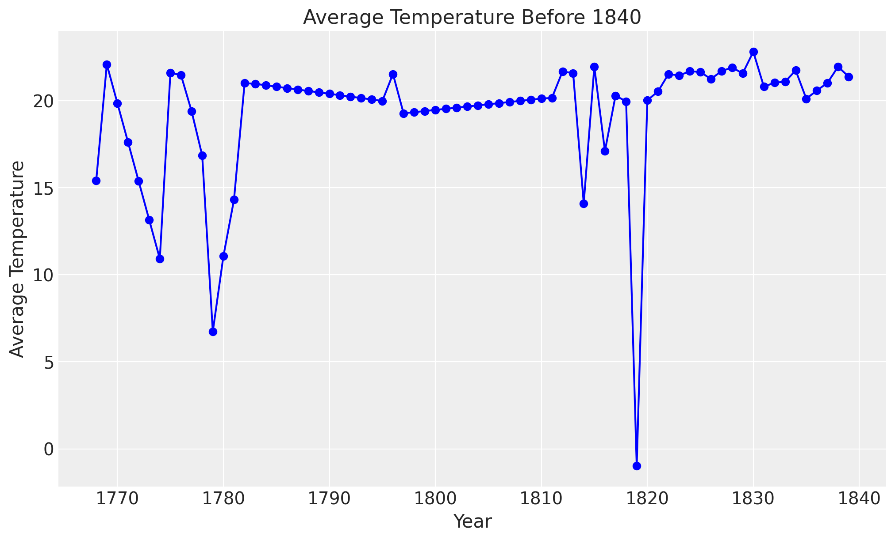
Observed Data - Pre 1840
Average Temperature is heavily fluctuating, but mostly around 20°C

Slide 9
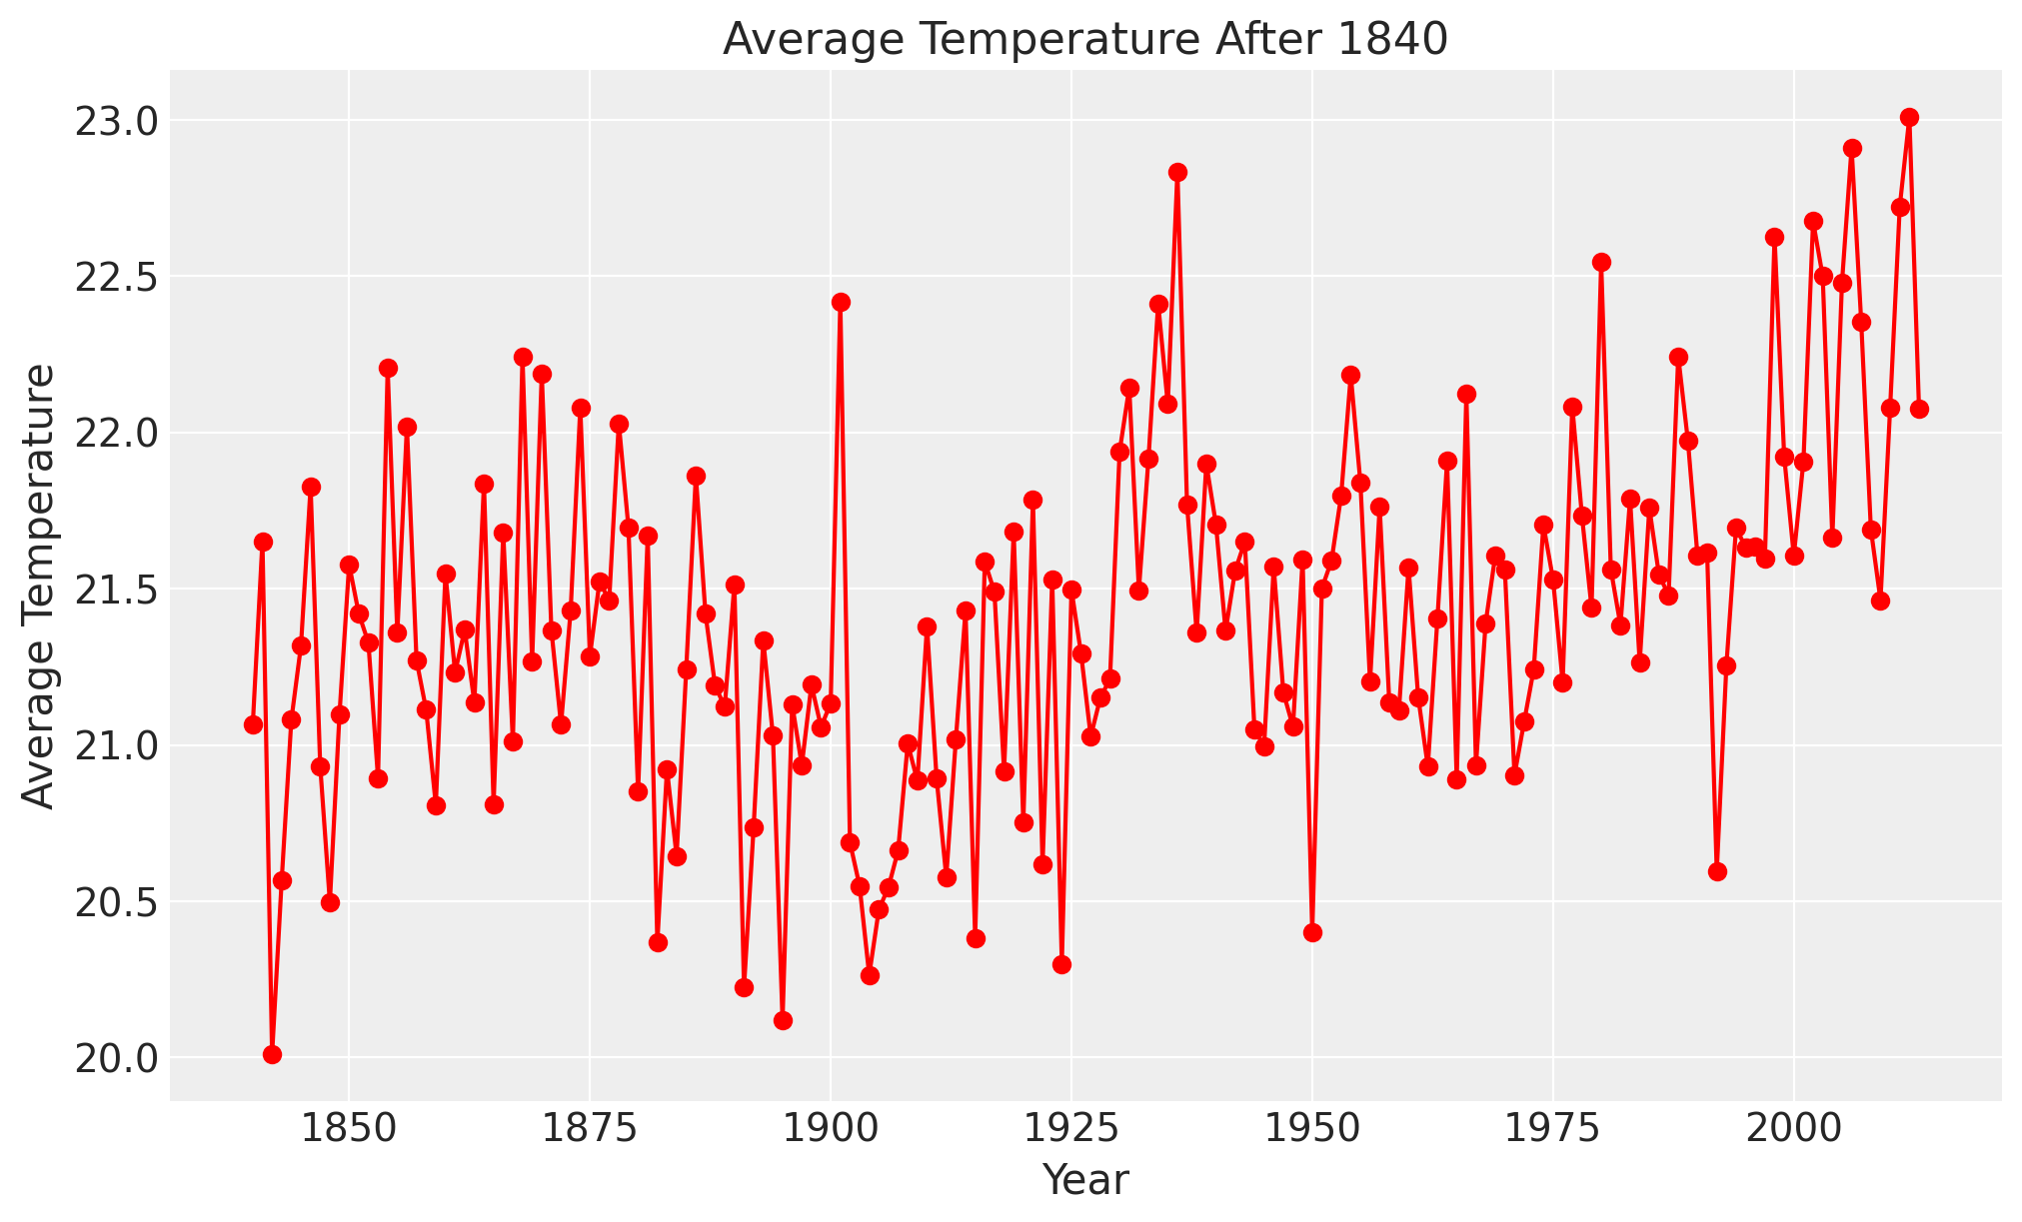
Observed Data - Post 1840
Average Temperature is stabilised, with less uncertainty and increased to above 20°C

Slide 10
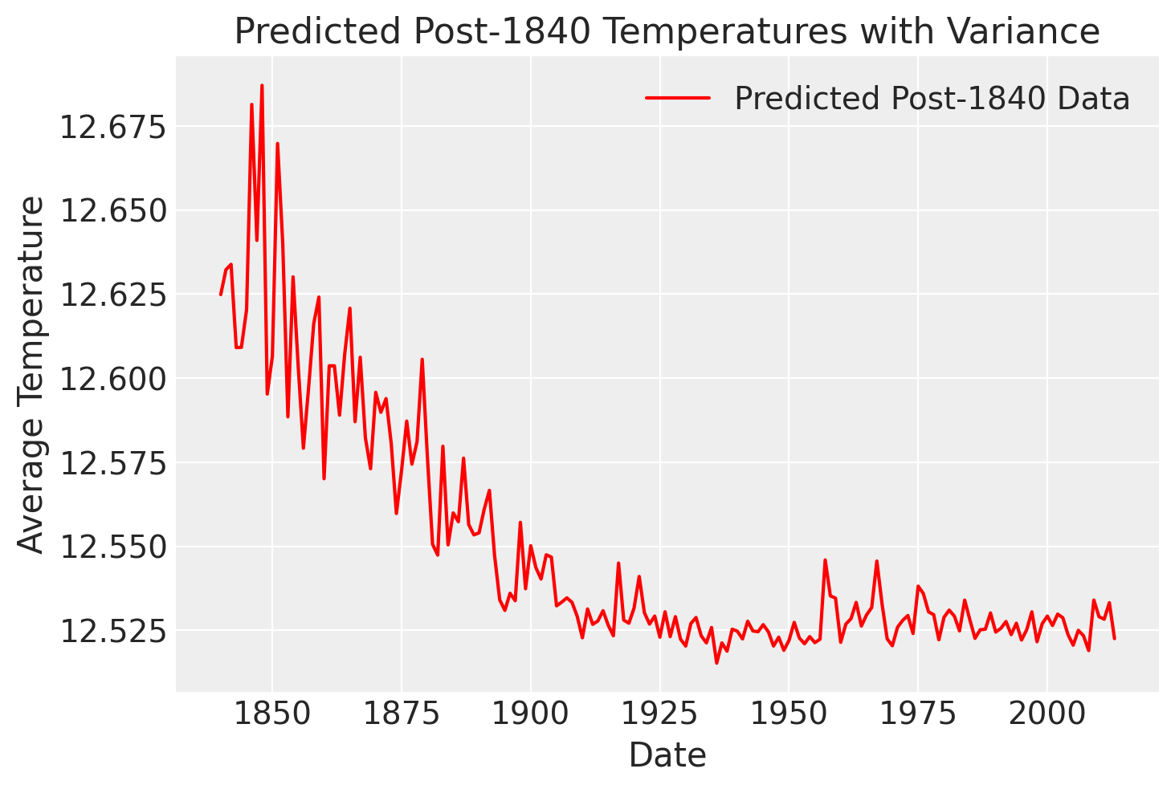
Initial Predictions
With our simple bayesian model we see that there is a downward trend for predicted temperatures, diverging from the slight upward trend observed in the actual post-1840 data. In order to better capture the complexity of our data we will introduce ensemble modeling

Slide 11
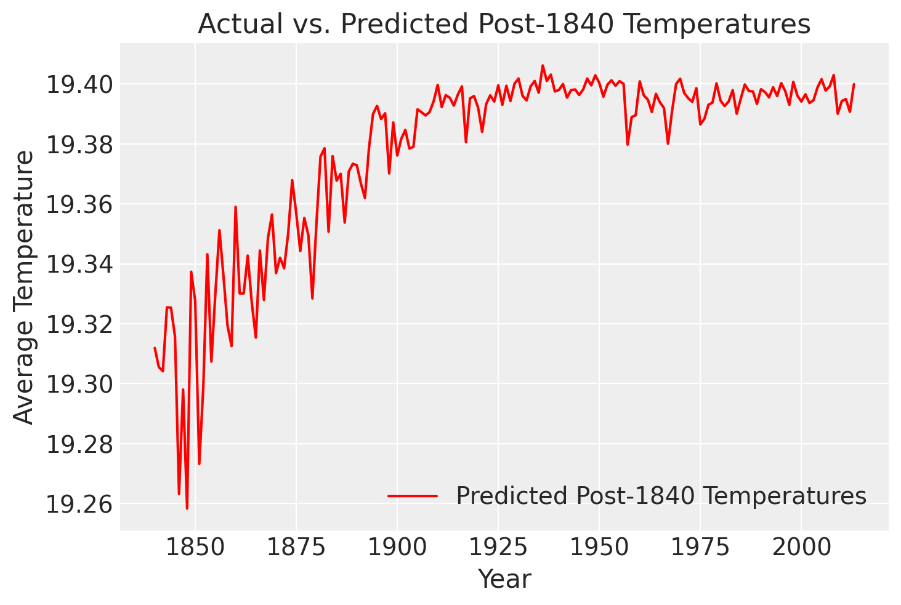
Ensemble Modeling (Bayesian + Ridge)
Bayesian Ridge Regression provides us with probabilistic estimates and regularization techniques to prevent overfitting. When combined with Bagging Regressor—an ensemble method—this combination offers improved robustness by reducing variance, capturing diverse data patterns, and enhancing the generalization capacity of the model. Combining weak-learning.

Slide 12
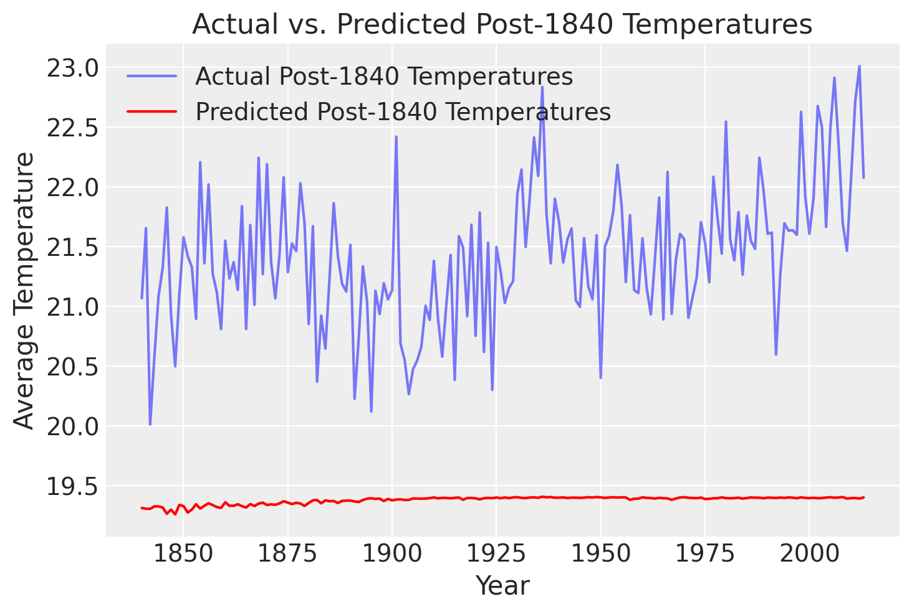
Evaluation (Posterior Predictive Analysis)

Slide 13
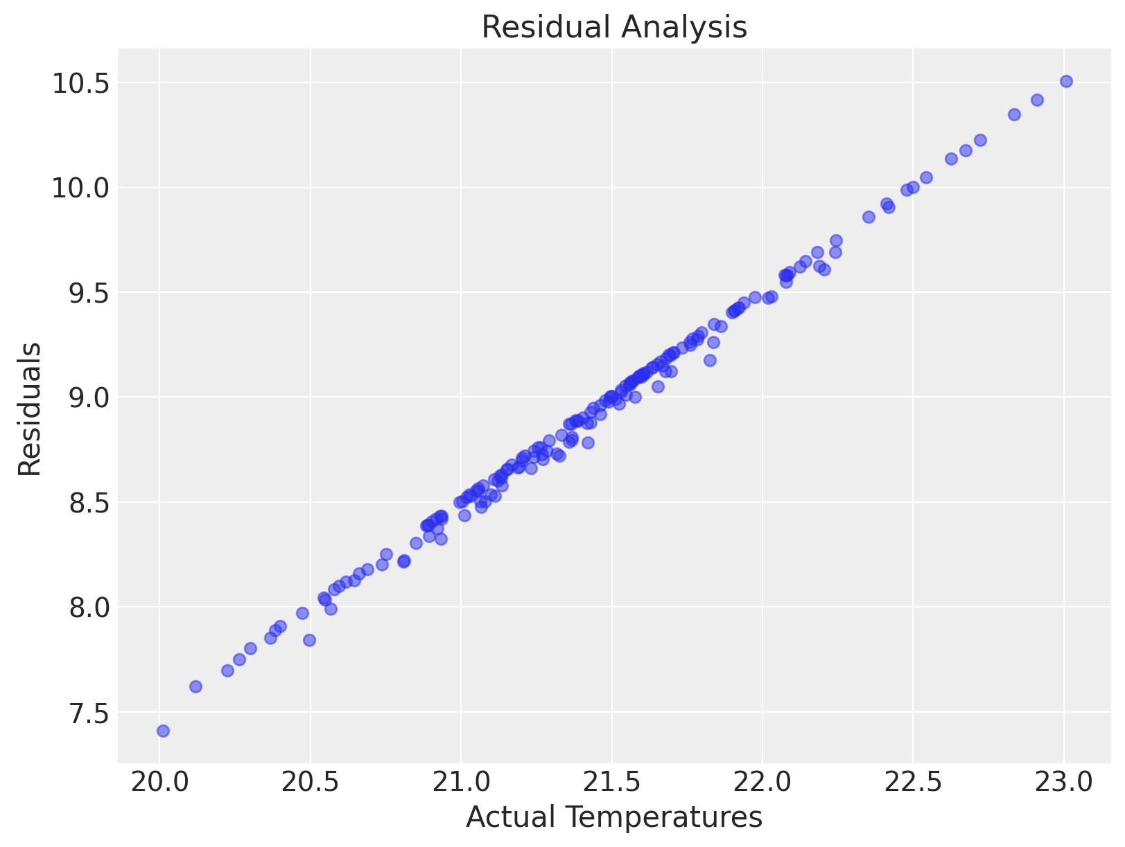
Evaluation Cont.
Mean Absolute Error (MAE): 8.90
Root Mean Squared Error (RMSE): 8.92
The estimated decrease in the global average temperature is approximately 8.9 degrees Celsius, indicating the potential cooling trend if the industrial revolution had not occurred. The model's Mean Absolute Error (MAE) of 8.90 degrees Celsius and Root Mean Squared Error (RMSE) of 8.92 degrees Celsius suggest the model's ability to reasonably predict this temperature decrease.

Slide 14
Conclusions
We see increasing trend in average temperature after year 1840
We think Industrial Revolution as a potential contributor to the observed temperature changes
Recognize significant uncertainty in temperature data pre-1840 due to computational limitations and its impact on the precision of posterior data analysis
Limitations:
Large uncertainty in the data prior to 1900,
Lack of other contributing variables & variable descriptions

Slide 15
Citations
Counterfactual Analysis of Time Series for Causal Inference :
https://bayesiancomputationbook.com/markdown/chp_06.html
Kaggle Dataset :
https://www.kaggle.com/datasets/berkeleyearth/climate-change-earth-surface-temperature-data?select=GlobalLandTemperaturesByCountry.csv
Missing Values Handling in Time Series :
https://www.section.io/engineering-education/missing-values-in-time-series/

